Slide 1
Predicting Good and Bad Movies using Storyline
By Yash Gondkar

Slide 2
Motivation
I am an ardent moviegoer
I love watching movies of some genres
However not all genres are equally
I am also a workaholic
Not to mention many movies flop these days as we have got accustomed to high quality content that we get on OTT, thanks to COVID

Slide 3
Motivation
Not a popularly solved problem
Tried several datasets
Some came close but none had the storyline
Many had missing monetary data
Monetary data will be used for initial labels

Slide 4
Data Collection
Too many problems!
Use a custom scraping script
Wikipedia is a good starting point
For the list of movies- Use TMDB
As an initial automated guess = Movie has become a ‘hit’

Slide 5
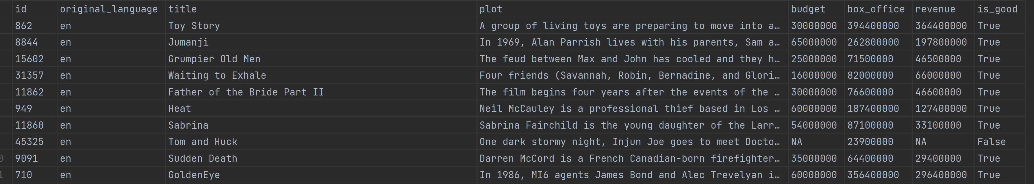
Data Collection

Slide 6
Implementation Details
I would be using Python for the scraper and the model
Libraries that I would be using –
Pytorch/Keras for building the model
BeautifulSoup 4 for scraping the data from web pages
I would use a 60/20/20 percentage data-split
Model will be a transformer-based architecture
ADAM optimizer
Also I would use GPU based computations for efficiency

Slide 7
Why Transformer-based Architecture?
A plain neural network checking just checking the presence/absence of words can’t capture the meaning
“Jhon beat Chris in chess” is not the same as “Chris beat Jhon in chess”
Therefore, I need a model that can make sense out of sequential data
Transformers are the state of the art in NLP and are the core building blocks for ChatGPT (GPT for Generative Pre-trained Transformer)
They make sense of sequential data by using something called “Self-Attention”
They were revolutionary because they overcame the vanishing/exploding gradient problems with RNNs (previous SOTA), and their internal operations could also be parallelized

Slide 8
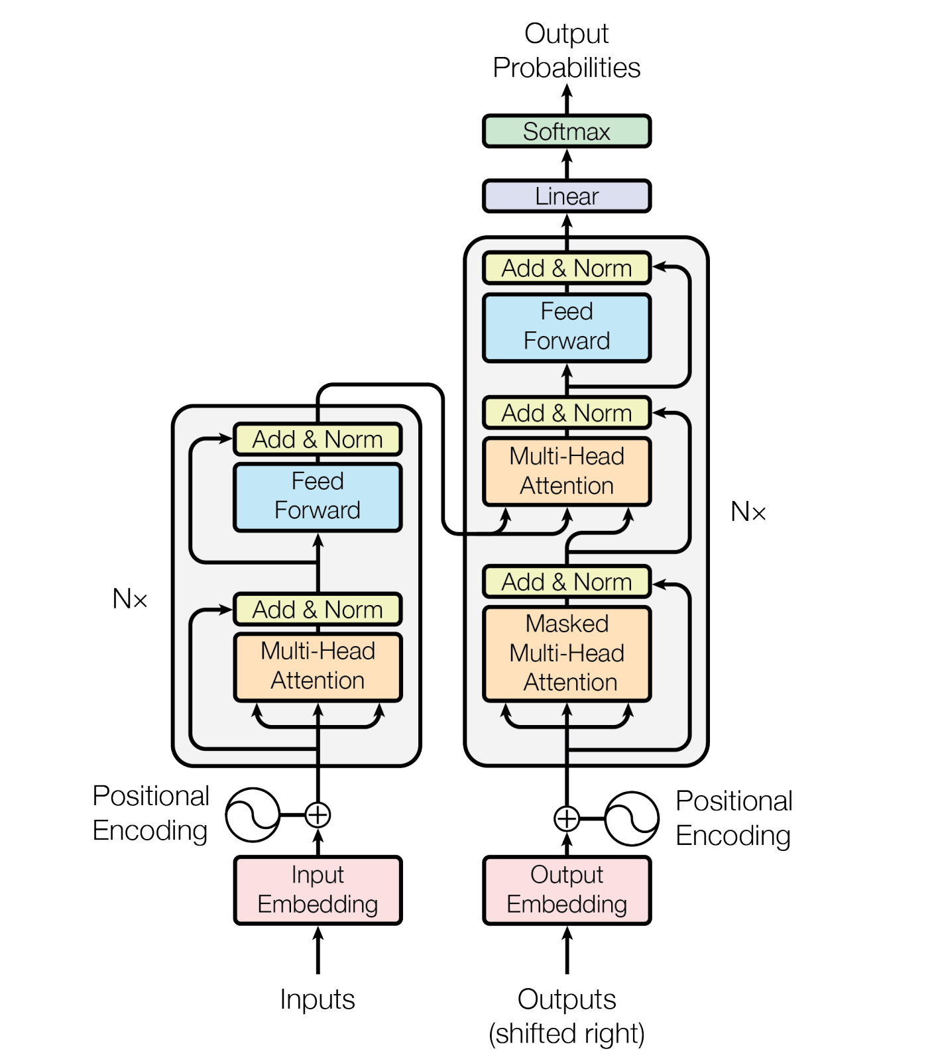
The Transformer - model architecture

Slide 9
Next Steps (Optional)
Train the model on more features like cast, release date, region, writer, director, production house, etc.
Improve the model by feeding video data instead of textual plot
Initially the video data will be either the movie trailer or a footage composed of small parts taken from the movie
Depending on the time and resources I can take it next level by using the entire movie videos (this is legal)
I can also create variants of the model for other tasks-
Box-office collection predictions
Genre prediction
Will the move be offensive for some audiences?
Expected rating

